Slide 1
Fake Product Review Monitoring and Removal for Genuine Online Product Reviews Using Opinion Mining

Slide 2
Contents
01. Introduction
07. Machine Learning Models
02. Objective
08. Performance Metric
03. Literature Review
09. Graph
04. Dataset
10. What sets us apart?
05. Preprocessing
11. Future Goals
06. Post Processing Analysis

Slide 3

Introduction
Nowadays, individuals buy things online through e-markets and e-commerce platforms.The details and feedback are also available to users.After observing these users purchase a product.
Before purchasing something, it is standard human behavior to do a product survey. Customers may use reviews to evaluate different brands and decide on a product that interests them. These internet reviews can influence a customer's impression of a product.
This can work against consumers since they can sometimes flood the review area with strong opinion comments, which can be beneficial or detrimental to the product.
Thus, we have to tackle this since it may be done by either the merchant to boost the value of the product or by the consumer to lower the product's ratings.

Slide 4

Objective:
This project proposes identifying, monitoring, and removing fraudulent or false reviews on product on online retail platforms utilizing advanced opinion mining techniques and machine learning algorithms.
The project also recommends classifying reviews as real or fake based on the wording used in the reviews, the product ratings, and so on.
To implement many algorithms for better spam detection, such as IP address, account used, Negative Word Dictionary with Sentiment analysis.
This method attempts to improve the validity and trustworthiness of customer reviews, allowing consumers to make more informed purchase decisions and preserving trust in the e-commerce industry.

Slide 5
Literature Review:
Title | Authors | Techniques | Limitations
Fake Product Review Monitoring System | Prof. K. B. Sadafale, Bhavana Narayan, Yash Patil, Vaishnavi Yelure | NLP and sentiment analysis are utilized in a methodology to assess the legitimacy of reviews, distinguishing between genuine feedback and spam. | Difficulty handling client feedback owing to the enormous volume of reviews.
Fake Product Review Monitoring and Removal for Genuine Product Reviews | Mayuri Patil, Snehal Nikumbh, Aparna Parigond, and Prof. Madhavi Patil | NLP algorithms are utilized to analyze product feedback, identifying and classifying reviews based on common terms, ensuring grammatical accuracy and purchase verification to prevent misleading buyers. | Indirect language in systems can lead to inaccurate classifications, causing issues with understanding sarcasm and recognizing false reviews, potentially causing false positives and harming honest reviewers.
What Yelp Fake Review Filter Might Be Doing? | Arjun Mukherjee, Vivek Venkataraman, Bing Liu, Natalie Glance | Yelp's analysis of reviews employs a supervised machine learning technique to identify false opinion spam, examining language and behavioral characteristics, reviewer patterns, and theoretic analysis to distinguish between crowdsourced and commercial phony reviews. | Difficulties in review detection include capturing complex behaviors and demonstrating intention, while Yelp's filtering may not always accurately reflect cultural and environmental factors influencing review authoring.

Slide 6
Contd..
Title | Authors | Techniques | Limitations
Exploiting Burstiness in Reviews for Review Spammer Detection | Geli Fei, Arjun Mukherjee, Bing Liu, Meichun Hsu, Malu Castellanos, Riddhiman Ghosh | The article discusses detecting review spammers using burstiness of reviews, techniques such as Markov Random Field (MRF), and the Loopy Belief Propagation (LBP) method that identifies sudden rise in product popularity, making it easier to detect spammers. | Review bursts may overlook sophisticated spammers, while human evaluations depend on subjective judgment, chosen attributes, potentially ineffective against legitimate spammers replicating review trends.
Opinion Fraud Detection in Online Reviews by Network Effects | Leman Akoglu,Rishi Chandy, Christos Faloutsos | FRAUDEAGLE, an unsupervised method, utilizes the network structure of reviewers and goods to identify fraudulent actions, utilizing network effects to detect abnormal user-product interactions. | The network structure of a system is crucial for its performance, but its adaptability to different review platforms and product categories is not fully established, and its real-world applicability in large datasets remains untested.
Detecting Fake Review Buyers Using Network Structure: Direct Evidence from Amazon | Sherry He, Brett Hollenbeck, Gijs Overgoor, Davide Proserpio, Ali Tosyalı | Clustering and unsupervised clustering are utilized in a network analysis to enhance accuracy in detecting fraudulent reviews and categorizing products.It uses network features like clustering coefficients and centrality indices | The network structure generated from Amazon data is crucial for the performance of the model, as it may not be applicable across other online platforms or less organized contexts.

Slide 7
Dataset:
The dataset containing reviews from an e-commerce platform(Amazon Vine program, where users get free products for genuine reviews), has several features, but we were particularly interested in the review_body column, which includes the text of the customer reviews.
The dataset includes 88,532 reviews.
The textual data in the review_body can be used to extract specific themes, identify prevalent issues, or improve overall customer satisfaction, which is crucial for informed business decisions.
Some reviews example:
It's great.
As advertised. Everything works perfectly, I'm very happy!.
These work great and fit my lifeproof case for the iPhone.
Work very well.
Be careful with these products, I have bought a few and this is the only one that hasn't had any battery issues.

Slide 8
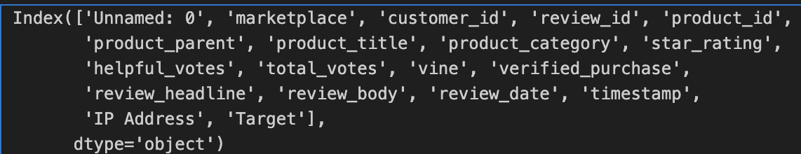
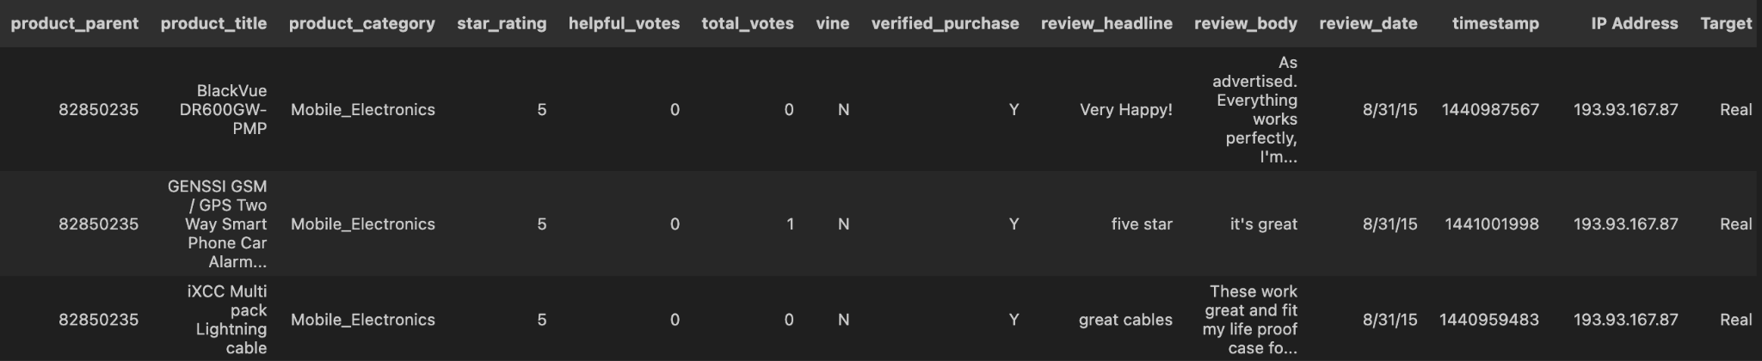
Add a new column 'Target' and initialize it with 'Real'
dataset['Target'] = 'Real'
print(dataset.columns)
dataset

Slide 9
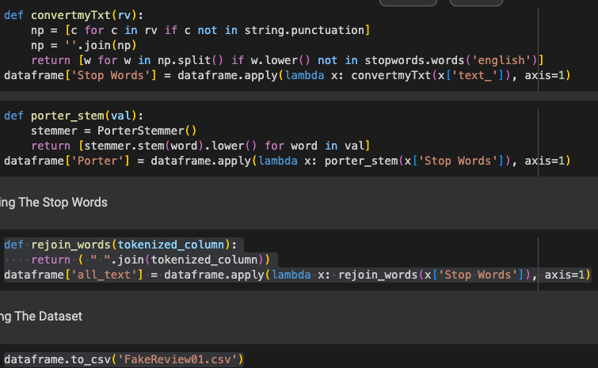
Data Preprocessing:
First checking If any column in a row has a missing value, that row is removed from the DataFrame. This is often done to ensure that the models that won’t encounter issues due to missing data.
Removes punctuation from the text and filters out common English stop words to reduce noise and focus on more meaningful words.
Using stemming function to standardize words to their root form, further normalizing the text for analysis.
Converts the list of important words back into a continuous string to prepare the processed text for machine learning.
Saves the modified DataFrame, which now includes cleaned and processed text, to a CSV file for future use or analysis into colum ‘all_text’

Slide 10
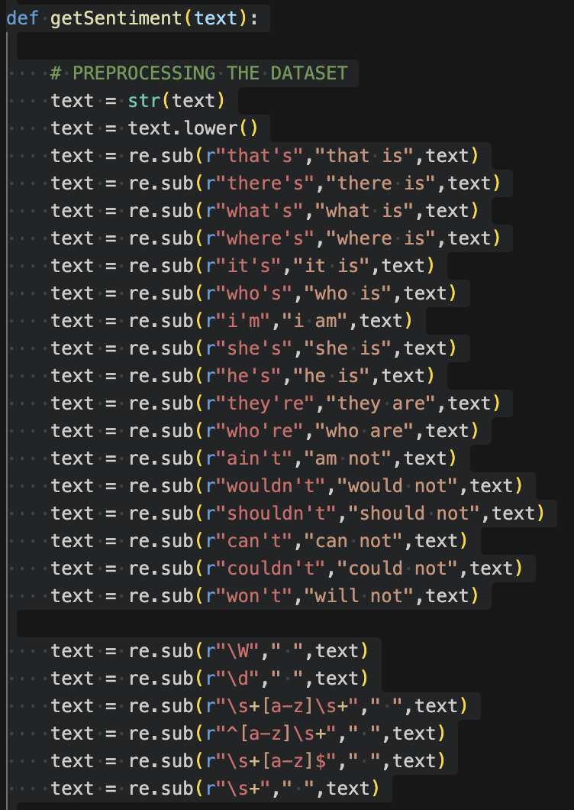
Sentiment classification:
Data Preparation:
sample_texts: contains a small set of review texts.
sample_labels: represents binary sentiment labels for the texts, where '1' indicates a positive sentiment and '0' indicates a negative sentiment.
Logistic Regression Classifier:
A logistic regression model is initialized and trained using the vector representations of the sample_texts produced by the TF-IDF vectorizer.
This model is used to predict the sentiment based on the vectorized form of any input text.
Text Preprocessing Function (getSentiment):
The function preprocesses input texts by converting them to lowercase, expanding contractions (like changing "I'm" to "I am"), and removing non-word characters and digits.
The output of the function is the predicted sentiment label ('1' for positive, '0' for negative).
Regular Expressions:
This includes handling contractions, removing non-alphabetic characters, and trimming extra spaces.

Slide 11
Post Processing Analysis - Methods used to determine Fake Reviews
Reviews with Conflicting Views
Brand Bias by Individual Users
Brand Bias from the Same IP Address
Review Flooding by a Single User
Mass Posting from a Single IP Address
Simultaneous Similar Reviews
Reviews with Coercive Language
Personal Narratives in Reviews
Nonsensical Text in Reviews

Slide 12
Reviews with Conflicting Views
For each review, it compares the sentiment of the review_headline to the sentiment of the review_body using a function called getSentiment. This function is presumed to analyze the text and return its sentiment.
Directly marks the dataset by adding in the column Target with the value 'Fake' for reviews where the sentiments conflict.
Number of reviews found Fake: 23417

Slide 13
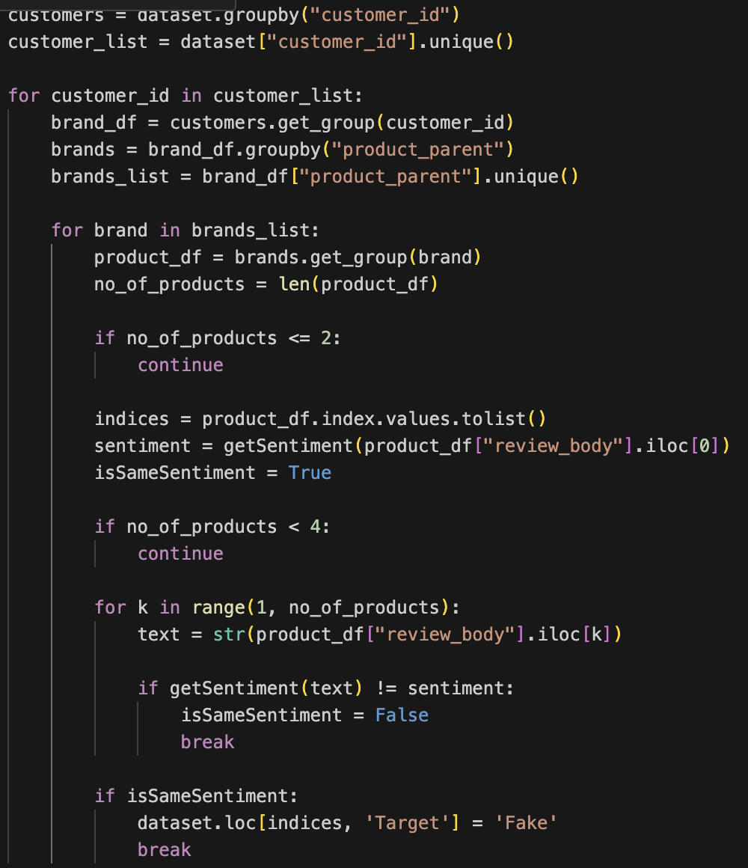
Brand Bias by Individual Users
A function “getSentiment” to analyze the sentiment of the first review’s text for a brand.
It checks if all reviews for the brand by the same customer_id share the same sentiment.
If any review has a different sentiment, it sets a flag “isSameSentiment” to False.
if all reviews share the same sentiment does it mark these reviews as potentially "Fake".
Number of reviews found Fake: 6

Slide 14
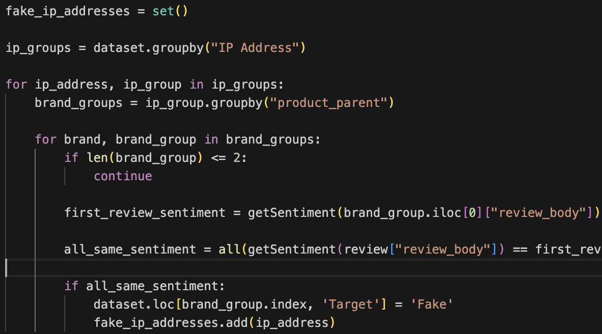
Brand Bias from the Same IP Address
Initializing a set called fake_ip_addresses to store the IP addresses associated with suspicious activity.
The dataset is grouped by the 'IP Address' column. This allows the analysis to focus on reviews submitted from the same IP address.
For each brand, the code checks if there are more than two reviews. Brands with two or fewer reviews from the same IP are ignored.
If all reviews from the same IP for a specific brand share the same sentiment.
it flags these reviews as 'Fake' by adding a 'Target' column to the dataset.
Number of reviews found Fake: 4

Slide 15
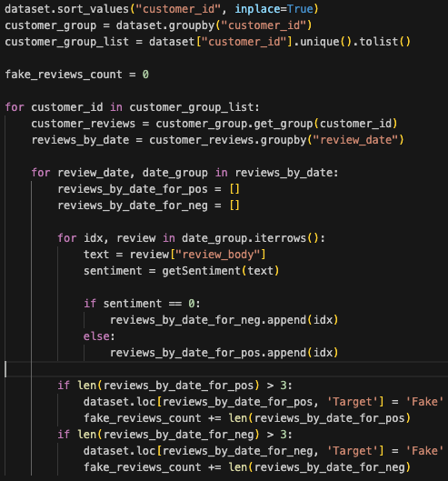
Review Flooding by a Single User
The dataset is grouped by customer_id, ensuring all dates are valid and can be grouped correctly.
Reviews are classified as positive or negative based on their sentiment.
If more than three reviews from the same customer on the same date are classified as either all positive or all negative, those reviews are flagged as 'Fake'.
Directly marks the dataset by adding in the column Target with the value 'Fake' for reviews where the sentiments conflict.
Number of reviews found Fake: 108

Slide 16
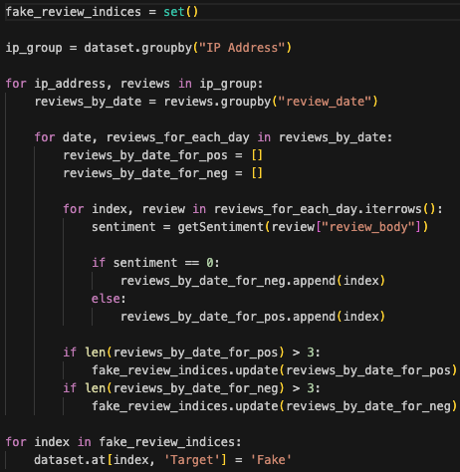
Mass Posting from a Single IP Address
A set named fake_review_indices is created to store indices of reviews that are determined to be fake based on the analysis.
The dataset is grouped by the 'IP Address' column. For each unique IP address, the reviews are further grouped by the 'review_date'.
If there are more than three positive or negative reviews from the same IP address on the same date, all such reviews are suspected to be fake.
Directly marks the dataset by adding in the column Target with the value 'Fake' for reviews where the sentiments conflict.
Number of reviews found Fake: 14

Slide 17
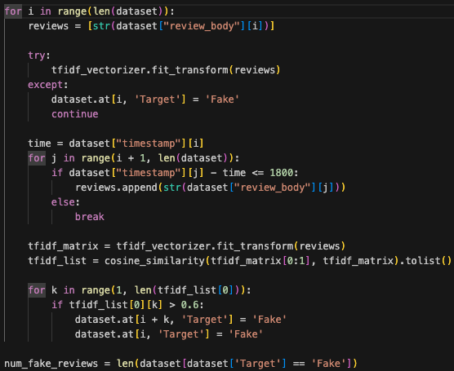
Simultaneous Similar Reviews
The dataset is first sorted by the timestamp column.
The code iterates through each review and attempts to find other reviews posted within a 30-minute window.
Reviews that are highly similar (cosine similarity > 0.6) to another within the same short time interval are flagged as 'Fake'.
This is done under the assumption that such reviews could be generated by bots or by individuals trying to manipulate review scores or perceptions.
Directly marks the dataset by adding in the column Target with the value 'Fake' for reviews where the sentiments conflict.
Number of reviews found Fake: 147

Slide 18
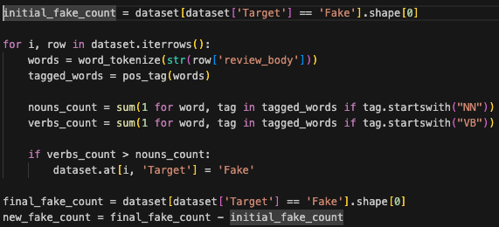
Reviews with Coercive Language
For each review in the dataset, the code tokenizes the review_body text splits it into words.
Then applies part-of-speech (POS) tagging to each word. POS tagging identifies each word as a noun, verb, adjective, etc.
Within the loop that processes each review, the code counts the number of nouns and verbs.
If a review has more verbs than nouns, it is marked as 'Fake'. This is based on an analytical decision that such a linguistic pattern (more verbs than nouns) might indicate falsified content.
The 'Target' column of such reviews is updated to 'Fake'.
Number of reviews found Fake: 19546

Slide 19
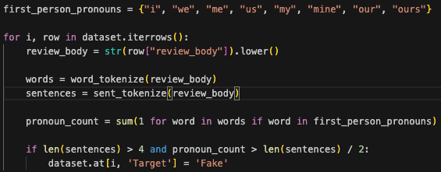
Personal Narratives in Reviews
The review text is converted to lowercase to standardize it and review is tokenized into words and sentences.
Counts how many words in the review are first-person pronouns.
if the number of first-person pronouns is more than half the number of sentences in reviews that have more than four sentences.
If this condition is met, the review is considered potentially 'Fake'.
The 'Target' column of such reviews is updated to 'Fake'.
Number of reviews found Fake: 8017

Slide 20
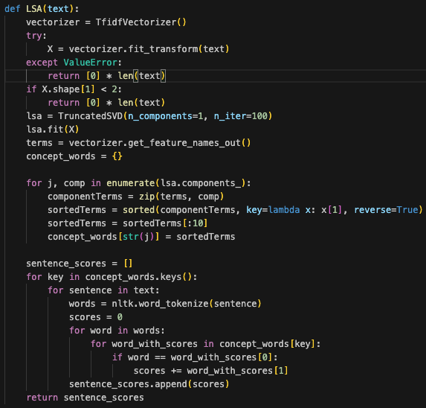
Nonsensical Text in Reviews
A function named LSA is defined to perform Latent Semantic Analysis on the cleaned text.
TruncatedSVD is used for dimensionality reduction, aiming to extract the most important underlying themes or topics in the reviews.
The number of components for SVD is set to 1, which simplifies the data to its most significant latent component.
The function calculates scores for each sentence by matching words in the sentence with the top words from the LSA components weighted by their importance.
For each product, it applies the LSA function to the cleaned reviews and scores each review based on its content relevance to the identified latent themes.
Reviews that receive a score of zero are flagged as "Fake".
Number of reviews found Fake: 2742

Slide 21
ML Models Used:
01.
Logistic Regression
02.
Random Forest Classifier
03.
Support Vector Classifier(SVM)

Slide 22
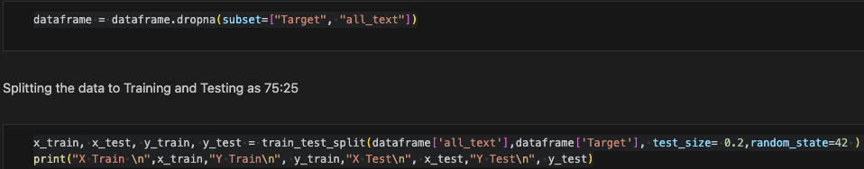
Training & Test
This “all_text” column presumably contains textual data that will be used as input features for a model. From the “Target” column of the DataFrame, which the model will try to predict.
x_train: The subset of the all_text column data reserved for training the model.
y_train: The subset of the Target column data (corresponding to x_train) that will be used to train the model.
x_test: The subset of the all_text column data reserved for testing the model.
y_test: The subset of the Target column data (corresponding to x_test) that will be used to test the model’s performance.

Slide 23
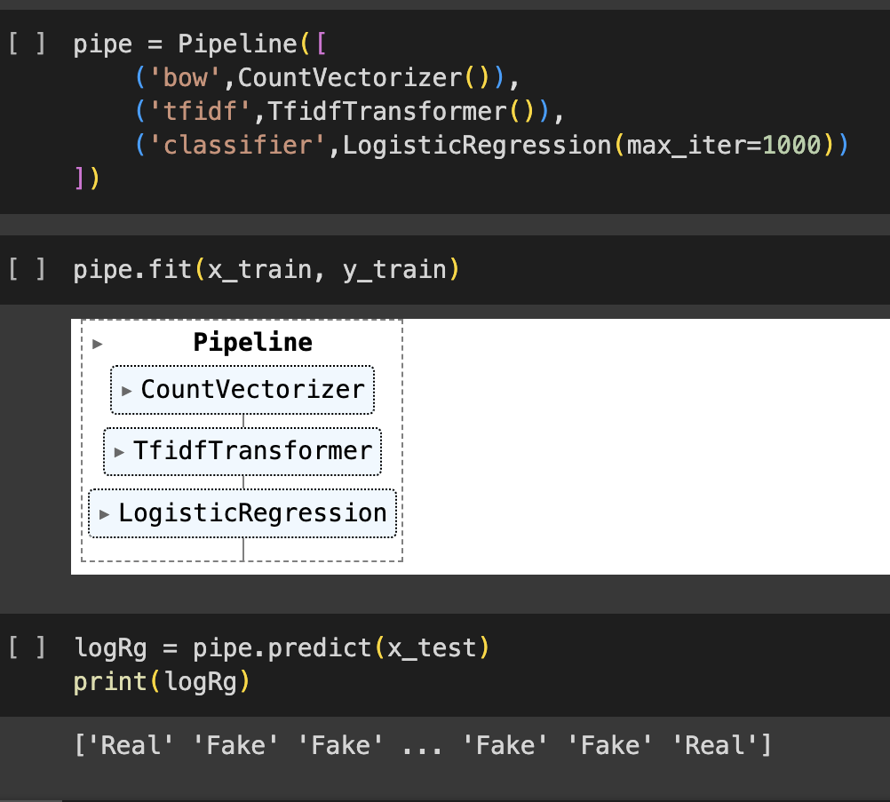
Logistic Regression
Logistic Regression is a statistical model used for binary classification that estimates probabilities using a logistic function. It is a form of regression that is suited when the dependent variable is binary. Logistic regression measures the relationship between the categorical dependent variable and one or more independent variables by estimating probabilities using a logistic function, which is an S-shaped curve that can take any real-valued number and map it into a value between 0 and 1.
Implemented within a pipeline that handles both the transformation and classification of text data. After converting text documents to a matrix of token counts. The count matrix from the CountVectorizer to a normalized TF or TF-IDF representation. TF-IDF stands for term frequency-inverse document frequency, which reflects how important a word is to a document in a corpus. This is crucial for weighting terms effectively based on their frequency and importance.

Slide 24
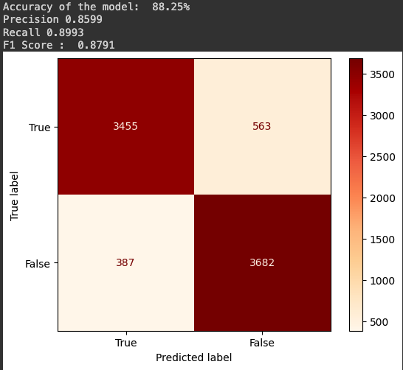
x_train contains the text data, and y_train contains the labels. The pipeline automatically applies text vectorization and TF-IDF transformation before fitting the model. After training, the model is used to predict labels for the test data. This demonstrates how the model performs on unseen data, a crucial step in evaluating the effectiveness of the model.The model is also used to predict the sentiment of new examples.

Slide 25
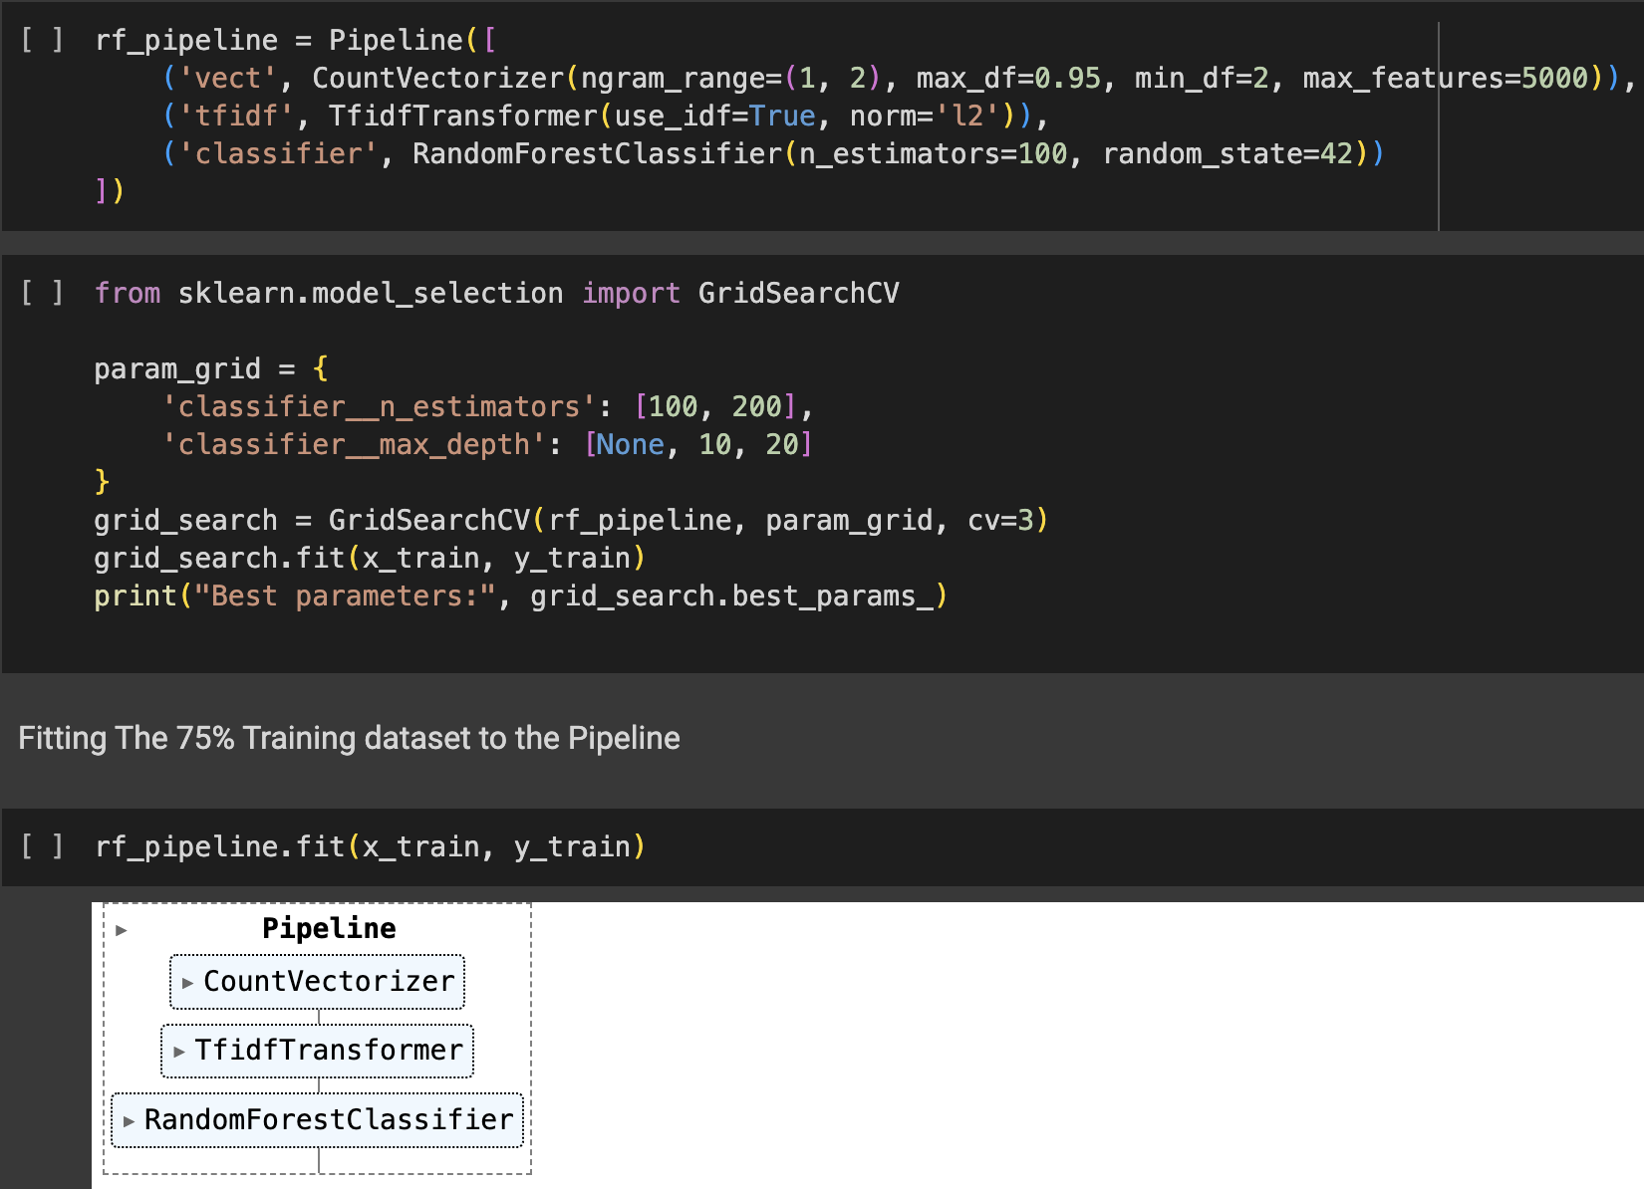
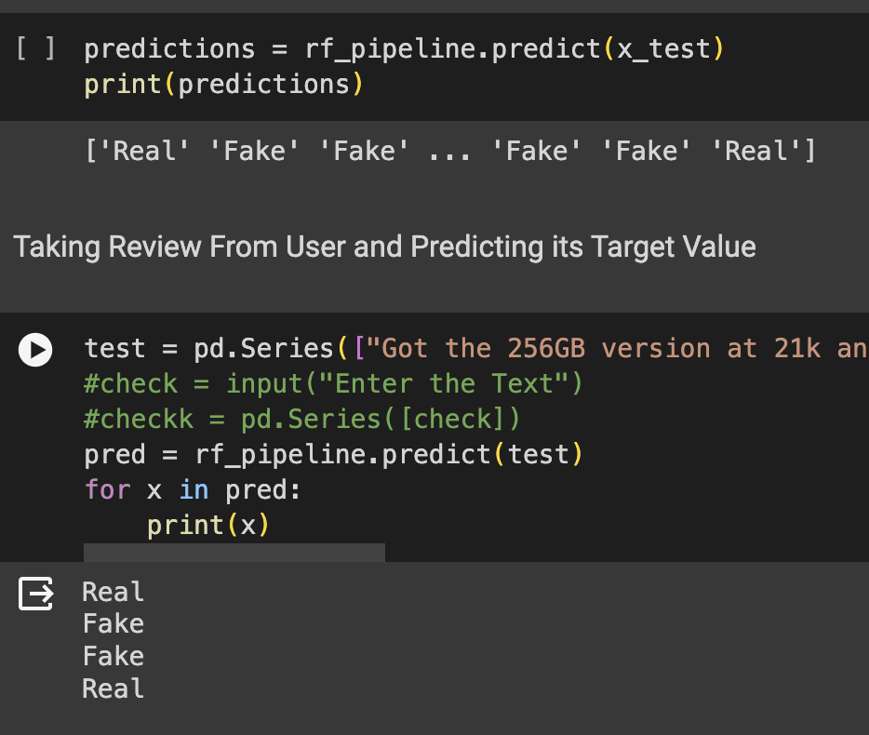
Random Forest Classifier
A Random Forest Classifier is an ensemble learning method that combines multiple decision trees to produce a more effective and robust model. Each tree in the forest makes a prediction, and the class with the most votes becomes the model's prediction. This method benefits from the diversity of its trees and is less likely to overfit compared to a single decision tree. It handles both classification and regression tasks effectively.
Converting text into a matrix of token counts but also considers unigrams and bigrams, filtering tokens that appear in more than 95% of the documents. TF-IDF representation, using inverse document frequency weighting and L2 normalization, which can help in minimizing the impact of token frequency across documents. A classifier that builds multiple decision trees and averages their results to improve prediction accuracy and control over-fitting, with a specified number of trees and a consistent random state for reproducibility

Slide 26
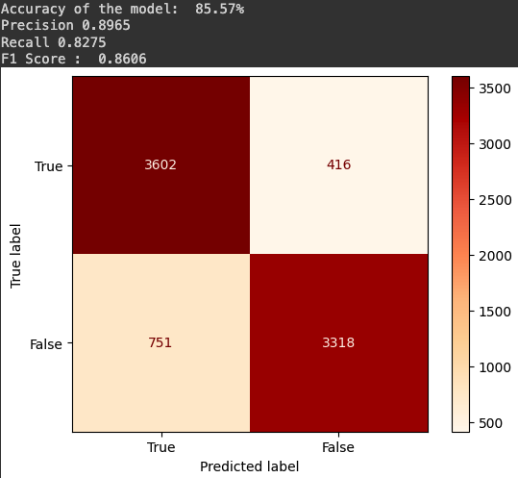
A 3-fold cross-validation is used to evaluate each combination of parameters from the grid to test with the RandomForestClassifier, Performing the grid search on the training data to find the best model parameters. The step is crucial for optimizing the model by finding the best parameters that lead to the highest predictive performance.
After determining the best parameters, the Random Forest pipeline is re-fit to the entire training dataset. It is then used to make predictions on both the test set and new text data to evaluate its performance and practical applicability.

Slide 27
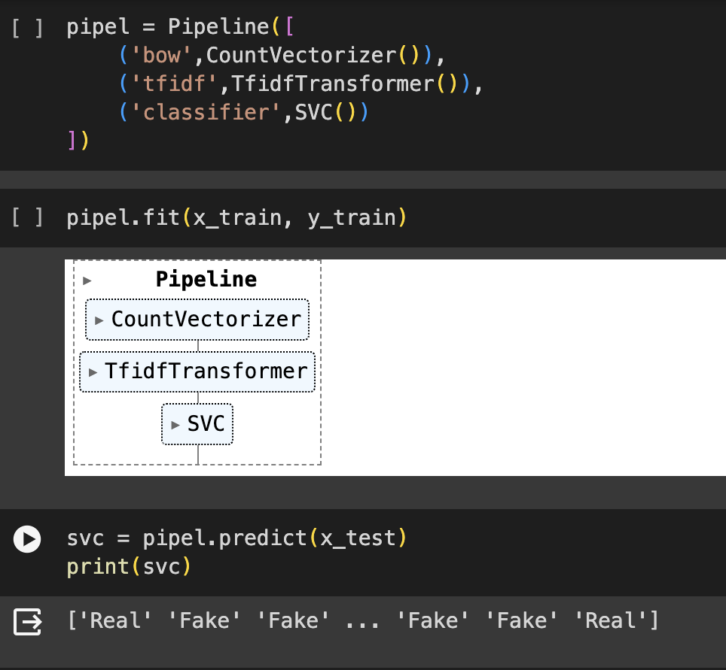
Support Vector Classifier(SVM)
A Support Vector Classifier is a powerful algorithm in the family of Support Vector Machines (SVM) designed for binary classification tasks. SVC constructs a hyperplane in an n-dimensional space that best separates the two classes of data points. The optimal hyperplane is chosen such that the margin of separation between the two classes is maximized. This model is particularly effective when the data is not linearly separable, as it can use what are called kernels to transform the data into a higher dimension where a hyperplane can be used to achieve separation.
Utilization of a Support Vector Machine (SVC) for a text classification encapsulated within a pipeline structure for streamlined processing. After converting text documents to a matrix of token counts. The count matrix from the CountVectorizer to a normalized TF or TF-IDF representation. In high-dimensional spaces, which is typical in text data due to the large vocabulary size the algorithm is highly effective.

Slide 28
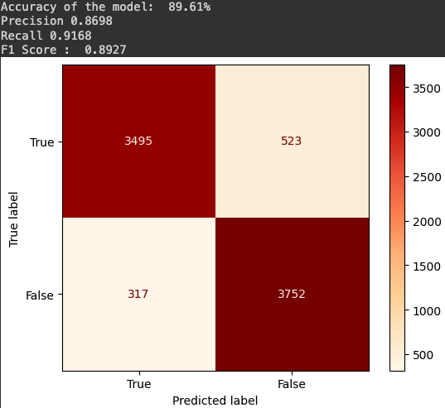
The pipeline is fitted with training data (x_train for text inputs and y_train for labels), where it executes text vectorization and TF-IDF transformations before fitting the SVC model. The trained model is then used to make predictions on the test dataset (x_test), and the predictions are done.
SVC is known for its robustness and effectiveness, especially in scenarios where the decision boundary between classes is not linear.

Slide 29
Performance Metrics
Accuracy: Measures the proportion of true results (both true positives and true negatives) among the total number of cases examined.
Precision: The ratio of correctly predicted positive observations to the total predicted positives. It is a measure of a classifier's exactness.
Recall (Sensitivity): The ratio of correctly predicted positive observations to all observations in actual class. It is a measure of a classifier's completeness.
F1 Score: The weighted average of Precision and Recall. Therefore, this score takes both false positives and false negatives into account.
Confusion Matrix Display: Visualizes the confusion matrix, providing a graphical representation of the model's performance, distinguishing between true positives, true negatives, false positives, and false negatives.

Slide 30
Model | Accuracy | Precision | Recall | F1 score
Random Forest Classifier | 85.57% | 89.65% | 82.75% | 86.06%
Logistic Regression | 88.25% | 85.99% | 89.93% | 87.91%
Support Vector Classifier(SVC) | 89.61% | 86.98% | 91.68% | 89.27%

Slide 31
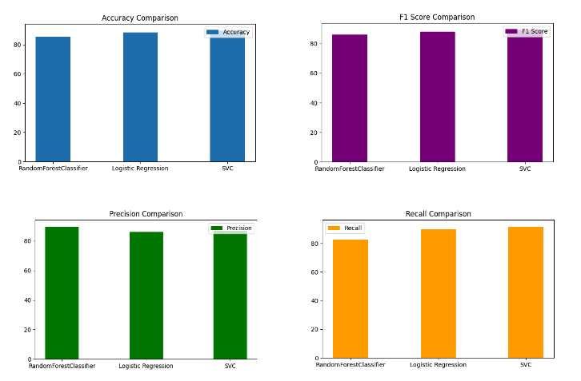
Graphs

Slide 32
What sets us apart ?
Extensive Post process Analysis
Diverse Algorithmic Approach
Scalable Architecture
Sentiment Analysis Integration

Slide 33
Thank You !
Professor Suzan Arslanturk
Yeswanth Vajja: HM0881 Nithish Pandian: HM8955

